Slide 1
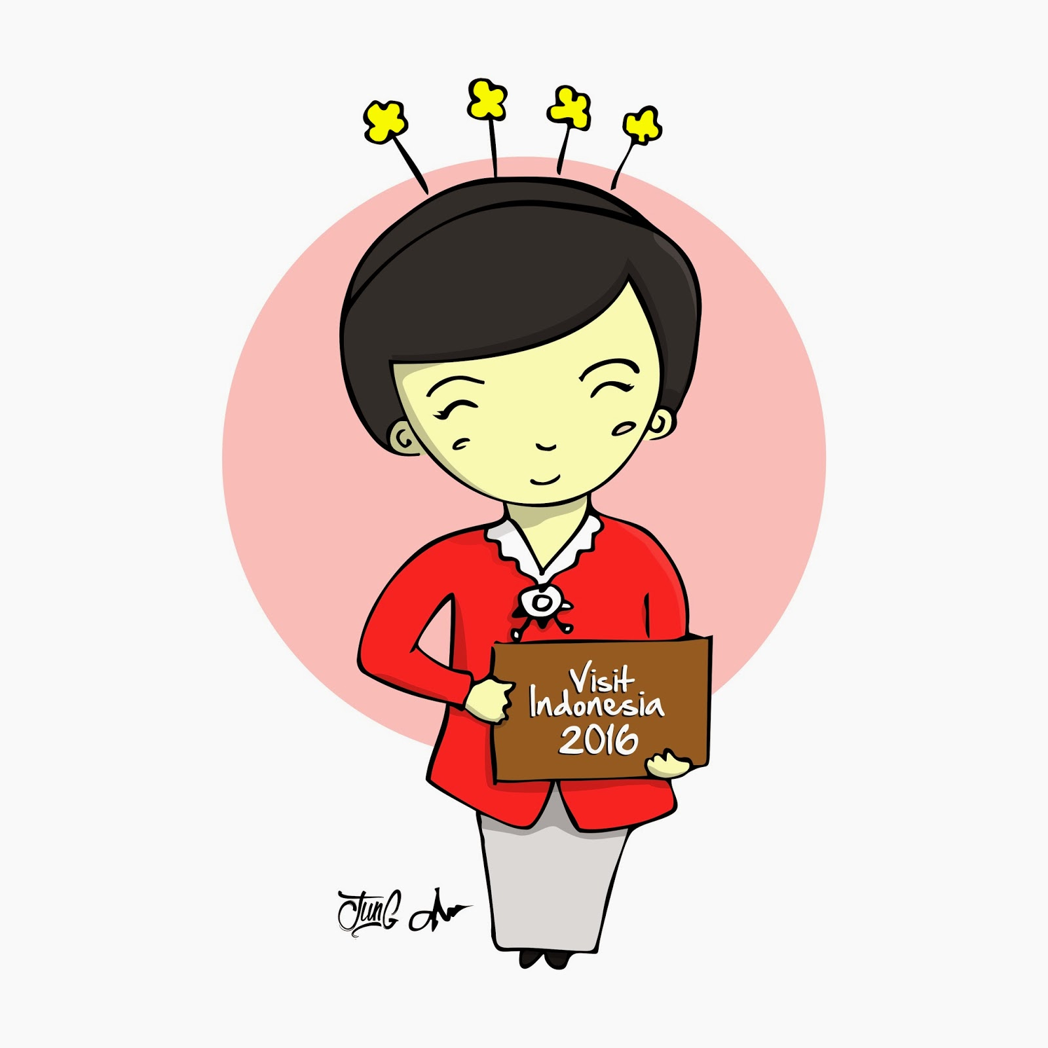
MbakYu
#YukPergi
image source: www.jungjawa.com

Slide 2
Personal Assistant

Slide 3
- Geofencing -
- Heat maps -
- Reminder based on time -
- Reminder based on movement -
- Share location tracking -
- Optimizing data transfer -

Slide 4
Move Sense https://github.com/Michinggun/MoveSense

Slide 5
Time Sense https://github.com/archansel/TimeSense

Slide 6
Piko Dove https://github.com/zavyra/PikoDove

Slide 7
Data Length
All data in bytes
Less is better

Slide 8
Parse Duration
All data in ms
Less is better
All data in ms
Less is better

Slide 9
Question?

Slide 10
Piko Format

